Slide 1
2.8 NXT Test Programs (Try Me Mode) U2C8

Slide 2
2.8 NXT Test Programs (Try Me Mode)
Overview:
This lesson explores the Try Me Mode built-in test programs of the NXT. Students run and analyze these demo programs which use the different NXT sensors.
Objectives: Students will be able to:
1. Run test programs on the NXT
2. Analyze programs to determine inputs, outputs and program flow

Slide 3
2.8 NXT Test Programs (Try Me Mode)
Note: If the Try Me Mode programs have been deleted from a brick, re-downloading the firmware will re-install the Try Me programs.
Goals
• Hands-on experience with operating the NXT brick
• Initial experience with running a program on the NXT brick
• Better understanding of the sensor functions
• Initial experience with Computational Thinking: determining the inputs, outputs and their relationship through program flow
Notes:
Note: If the Try Me Mode programs have been deleted from a brick, re-downloading the firmware will re-install the Try Me programs.
Goals
Hands-on experience with operating the NXT brick
Initial experience with running a program on the NXT brick
Better understanding of the sensor functions
Initial experience with Computational Thinking: determining the inputs, outputs and their relationship through program flow
Procedure
Student will add sensors and motors to build an NXT computer and then run the built-in Try Me programs
Have student power up bricks and navigate to the “Try Me” Menu
Have students run each of the five programs and complete the “Try Me” Worksheet [10]
The name of the program (e.g. Try-Touch) indicates which sensor needs to be attached
Students observation and analysis should connected back to both:
The Parts of a Computer (Input, Output, Processor and Storage)
The attributes of a robot:
manufactured by Lego
sense environment (input)
respond to instructions:
program flow is the instructions
output gives evidence of response

Slide 4
2.8 NXT Test Programs (Try Me Mode)
Procedure
• Student will add sensors and motors to build an NXT computer and then run the built-in Try Me programs
• Student will power up brick and navigate to the “Try Me” Menu
• Student will run each of the five programs and complete the “Try Me” Worksheet
◦ The name of the program (e.g. Try-Touch) indicates which sensor needs to be attached
Notes:
Note: If the Try Me Mode programs have been deleted from a birck, re-downloading the firmware will re-install the Try Me programs.
Goals
Hands-on experience with operating the NXT brick
Initial experience with running a program on the NXT brick
Better understanding of the sensor functions
Initial experience with Computational Thinking: determining the inputs, outputs and their relationship through program flow
Procedure
Student will add sensors and motors to build an NXT computer and then run the built-in Try Me programs
Have student power up bricks and navigate to the “Try Me” Menu
Have students run each of the five programs and complete the “Try Me” Worksheet [10]
The name of the program (e.g. Try-Touch) indicates which sensor needs to be attached
Students observation and analysis should connected back to both:
The Parts of a Computer (Input, Output, Processor and Storage)
The attributes of a robot:
manufactured by Lego
sense environment (input)
respond to instructions:
program flow is the instructions
output gives evidence of response

Slide 5
2.8 NXT Test Programs (Try Me Mode)
• Student observations and analysis should connected back to both:
◦ The Parts of a Computer (Input, Output, Processor and Storage)
◦ The attributes of a robot:
■ manufactured by Lego
■ sense environment (input)
■ respond to instructions:
■ program flow is the instructions
■ output gives evidence of response
Notes:
Note: If the Try Me Mode programs have been deleted from a birck, re-downloading the firmware will re-install the Try Me programs.
Goals
Hands-on experience with operating the NXT brick
Initial experience with running a program on the NXT brick
Better understanding of the sensor functions
Initial experience with Computational Thinking: determining the inputs, outputs and their relationship through program flow
Procedure
Student will add sensors and motors to build an NXT computer and then run the built-in Try Me programs
Have student power up bricks and navigate to the “Try Me” Menu
Have students run each of the five programs and complete the “Try Me” Worksheet [10]
The name of the program (e.g. Try-Touch) indicates which sensor needs to be attached
Students observation and analysis should connected back to both:
The Parts of a Computer (Input, Output, Processor and Storage)
The attributes of a robot:
manufactured by Lego
sense environment (input)
respond to instructions:
program flow is the instructions
output gives evidence of response

Slide 6
Worksheet
“Try Me” Mode Exercise
Name:_________________________ Period:___ Date:________ Score:_____/50
(10 pts) For each of the 5 “Try Me” Mode programs:
Describe what you observe
Identify the inputs and outputs of the NXT computer being used
Briefly describe what you think the program steps are (for example: - wait for button to be pressed - turn on light - wait for button to be released - play a sound)
Try Touch
-
-
-
>
>
>
Try Light
-
-
-
>
>
>
Try Ultrasonic
Try Motor
Try Sound
Notes:
Answer Key:
NXT Test Programs (Try Me Mode) [1]
Submitted by Randy Steele [2] on 12 July, 2011 - 09:01
Answer Key: “Try Me” Mode Worksheet
1. Try Touch a – pressing the sensor causes the displayed lego dude to open his mouth and make a sound b – input: touch sensor, outputs: LCD screen and speaker c > display closed mouth > wait for sensor to be pressed > change screen image and make sound > wait for sensor to be released Start over
2. Try Light a – moving the sensor causes the sound to change b – input: light sensor, output: speaker c > make sound > if reflected light increases, increase pitch of sound > if reflected light decreases, decrease pitch of sound Start over
3. Try Ultrasonic a – moving the sensor causes the sound to change b – input: ultrasonic sensor, output: speaker c > make sound > if distance to object increases, increase pitch of sound > if distance to object decreases, decrease pitch of sound > if sensor touches object, make high pitch sound Start over
4. Try Motor a – moving the motor causes the sound to change b – input: motor, output: speaker c > make sound > if motor rotates away from starting point, increase pitch of sound > if motor rotates toward starting point, decrease pitch of sound Start over
5. Try Sound a – making sounds causes the motor to move b – input: sound sensor, output: motors (AorB) c > if sounds increases, increase speed of motors > if sounds decreases, decrease speed of motors Start over
Source URL: http://stemrobotics.cs.pdx.edu/node/378

Slide 7
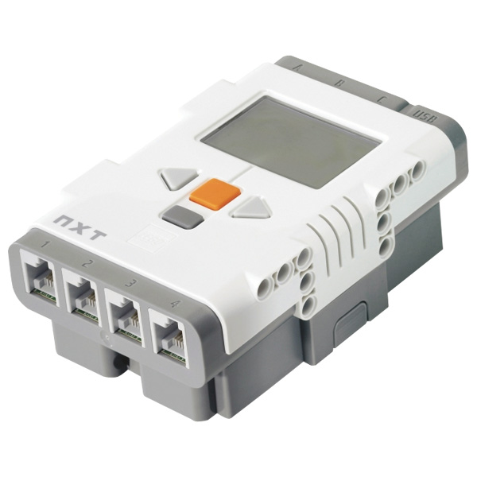
NXT Computer Video
5:29-8:12
Notes:
Instructional Material: Show from 5:29-8:12
The NXT Computer_Video [1]
Submitted by Randy Steele on 12 July, 2011 - 08:05
This NXT Introduction video [3] was developed by Dale Yocum (Catlin Gabel School, Portland, OR) as part of his NXT Tutorial series. These videos have been linked as Alternative and Supplemental Differentiated Instructional Resources to their corresponding sections in this STEM Robo101 curriculum. This NXT Introduction video covers the NXT brick, sensors, menu system and more.
Material Type: Tutorial
Education Level: Middle School [4]High School [5]
Focus Subject: Robotics Hardware [6]Technology [7]
Interactivity Style: Mixed [10]
Copyright (c) 2011 by the author. All rights reserved.
Source URL: http://stemrobotics.cs.pdx.edu/node/371

Slide 8
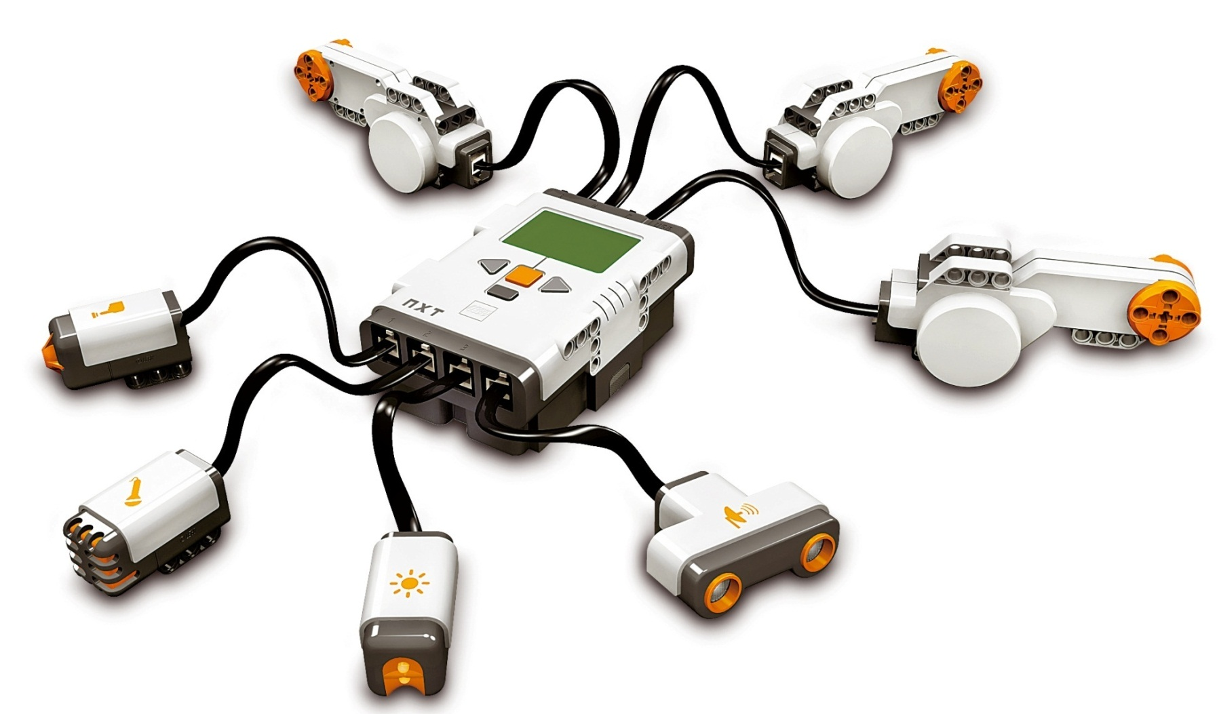
The “Try me” Mode
Turn on NXT
select “Settings”
Select “Volume”
Change to 1 with arrows
Press “Back” when done
Notes:
The “Try me” Mode
2. Turn on NXT
3. select “Settings”
4. Select “Volume”
5. Change to 1 with arrows
6. Press “Back” when done

Slide 9
The “Try-Touch” Mode
Select “Try Me”
Select “Try-Touch”
Run
Follow directions… (Connect a Touch Sensor to Port 1)
Follow directions…
Press “Back” when done
Go to next sensor “Try- …”
Notes:
The “Try me” Mode
Connect a Touch Sensor to Port 1
Turn on NXT & select “Try M
Select “Try-Touch”
Run
Follow directions… 6
Press “Back” when done
Go to next sensor “Try Me”…

Slide 10
The “Try-Light” Mode
Select “Try Me”
Select “Try-Light”
Run
Follow directions… (Connect a Light Sensor to Port 3)
Follow directions…
Press “Back” when done
Go to next sensor “Try- …”
Notes:
The “Try me” Mode
Connect a Touch Sensor to Port 1
Turn on NXT & select “Try M
Select “Try-Touch”
Run
Follow directions… 6
Press “Back” when done
Go to next sensor “Try Me”…

Slide 11
The “Try-Ultrasonic” Mode
Select “Try Me”
Select “Try-Ultrasonic”
Run
Follow directions… (Connect a Ultrasonic Sensor to Port 4)
Follow directions…
Press “Back” when done
Go to next sensor “Try- …”
Notes:
The “Try me” Mode
Connect a Touch Sensor to Port 1
Turn on NXT & select “Try M
Select “Try-Touch”
Run
Follow directions… 6
Press “Back” when done
Go to next sensor “Try Me”…

Slide 12
The “Try-Motor” Mode
Select “Try Me”
Select “Try-Motor”
Run
Follow directions… (Connect a Motor Sensor to Port A)
Follow directions…
Press “Back” when done
Go to next sensor “Try- …”
Notes:
The “Try me” Mode
Connect a Touch Sensor to Port 1
Turn on NXT & select “Try M
Select “Try-Touch”
Run
Follow directions… 6
Press “Back” when done
Go to next sensor “Try Me”…

Slide 13
The “Try-Sound” Mode
Select “Try Me”
Select “Try-Sound”
Run
Follow directions… (Connect a Motor to Port B or C)
(Connect a Sound Sensor to Port 2)
Follow directions…
Press “Back” when done
Go to next sensor “Try- …”
Notes:
The “Try me” Mode
Connect a Touch Sensor to Port 1
Turn on NXT & select “Try M
Select “Try-Touch”
Run
Follow directions… 6
Press “Back” when done
Go to next sensor “Try Me”…

Slide 14
Worksheet
The NXT Computer Name:__________________ Period:___ Date:______ Score:___/14
(4 pts) Name the four parts of a computer & give an example of an NXT component for each.
(4 pts) Identify which part of a computer each of the following NXT component represent:
The Brick buttons:
Sound sensor:
Light:
LCD screen:
The Brick’s “brain”:
Touch sensor:
The Brick’s Flash memory:
(3 pts) Which NXT component can be used as two different parts of a computer?
Describe how.
(3 pts) What are the three types of memory chips? How is each used in the NXT computer?
Notes:
Answer Key:
The NXT Computer_Worksheet [1]
Submitted by Randy Steele [2] on 12 July, 2011 - 07:47
Answer Key: The NXT Computer Worksheet
Input – NXT Brick Buttons, Sensors, Motors Output – NXT Brick LCD Screen, NXT Brick Speaker, Motors, Lights Processor – NXT Brick Processor (“brain”) Storage – NXT Brick Flash Memory Chips
See above
Motors – can be both inputs (rotation sensor) and outputs (motor movement) NXT Brick – LCD Screen and Speaker are outputs and Buttons are inputs
ROM – stores firmware from Lego RAM – stores student’s software (programs) when running Flash – stores both firmware and software
Source URL: http://stemrobotics.cs.pdx.edu/node/366

Slide 16
Introduction to Computers Review
Jeopardy
Notes:
This is the Unit review.

